Slide 1
Mobile Radio Propagation:
Large-Scale Path Loss
(S. Rappaport, wireless communications)
Notes:
The mobile radio channel places fundamental limitations on the performance of wireless communication systems. The transmission path between the transmitter and the receiver can vary from simple line-of-sight to one that is severely obstructed by buildings, mountains, and foliage. Unlike wired channels that are stationary and predictable, radio channels are extremely random and do not offer easy analysis. Even the speed of motion impacts how rapidly the signal level fades as a mobile terminal moves in space. Modeling the radio channel has historically been one of the most difficult parts of mobile radio system design, and is typically done in a statistical fashion, based on measurements made specifically for an intended communication system or spectrum allocation.

Slide 2
Basics - Propagation
Radio waves
    Are easy to generate
    Can travel long distances
    Can penetrate buildings
    They are both used for indoor and outdoor communication
    They are omni-directional: can travel in all directions
    Properties of radio waves are frequency dependent
        At low frequencies, they pass through obstacles well, but the power falls off sharply with distance from source
        At high frequencies, they tend to travel in straight lines and bounce of obstacles (they can also be absorbed by rain)
        They are subject to interference from other radio wave source
CS 515

Slide 3
Propagation Modes
Wireless transmissions propagate in three modes:
  Ground Wave
  Sky Wave
  Line-of-Sight (LoS)

Slide 4
Contd.
  Ground Wave
  Ground wave propagation follows the contour/curvature of the earth, this is due to EM waves induce current in the earth's surface.
  This causes wave-front to bend towards the earth and follow/propagate earth's surface.
  Frequencies up to about 2MHz fall in this category of propagation.
  Typical applications include AM radio broad-casting, direction finding, submarine communication, home control systems, analog telephone lines, long range navigation and more.

Slide 5
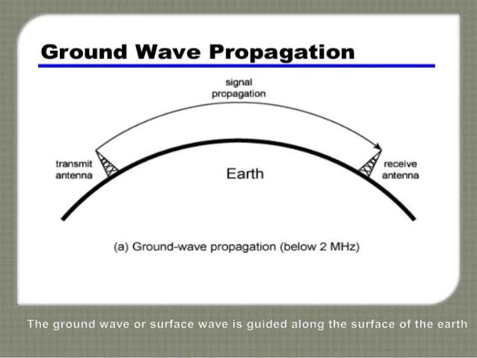

Slide 6
Contd.
  Sky Wave
  Sky wave propagation uses reflection by both earth and ionosphere.
  Here ionosphere above earth's surface reflect the transmitted wave and hence it gets propagated due to reflection.
  Frequencies between 2 MHz and 30 MHz fall in this category of propagation.
  Typical applications include international broad casting, military communication and long range aircraft/ship communication.

Slide 7
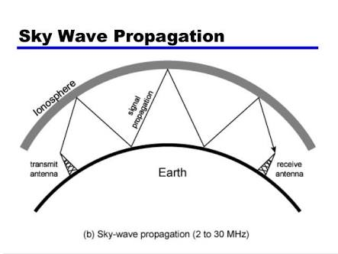

Slide 8
Contd.
  Line-of-Sight (LoS)
The line of sight propagation requires the transmitting and receiving antennas to be within line of sight of each other.
Here signal above 30MHz are not reflected by ionosphere and here it is transmitted based on line-of-sight concept.
For satellite application, it is transmitted from earth station antenna to the satellite antenna.
For ground based wireless link, communication happens when both the transmit(Tx) and receive(Rx) antennas are in the line of sight of each other.
Frequencies above 30 MHz fall in this category of propagation.
Typical applications include VHF/UHF television, FM broad cast, optical communication, Infrared LANs, terrestrial wireless link, radar, cellular telecom, PCS, WLL and more.

Slide 9
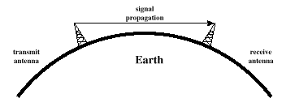
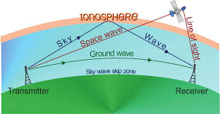
Line-of-Sight Propagation

Slide 10





Introduction to Radio Wave Propagation
Reflection
  Large buildings, earth surface
Diffraction
  Obstacles with dimensions in order of wavelength
Scattering
  Foliage, lamp posts, street signs, walking pedestrian, etc.
τ_{max}
received
signal
transmitted
signal
T_{s}
Notes:
The mechanisms behind electromagnetic wave propagation are diverse, but can generally be attributed to reflection, diffraction, and scattering. Most cellular radio systems operate in urban areas where there is no direct line-of-sight path between the transmitter and the receiver, and where the presence of high-rise buildings causes severe diffraction loss. Due to multiple reflections from various objects, the electromagnetic waves travel along different paths of varying lengths. The interaction between these waves causes multipath fading at a specific location, and the strengths of the waves decrease as the distance between the transmitter and receiver increases.

Slide 11
Large-scale propagation models
large-scale propagation models characterize signal strength over large T-R separation distances
small-scale or fading models: characterize the rapid fluctuations of the received signal strength over very short travel distances or short time durations
Notes:
Propagation models have traditionally focused on predicting the average received signal strength at a given distance from the transmitter, as well as the variability of the signal strength in close spatial proximity to a particular location. Propagation models that predict the mean signal strength for an arbitrary transmitter-receiver (T-R) separation distance are useful in estimating the radio coverage area of a transmitter and are called large-scale propagation models, since that characterize signal strength over large T-R separation distances (several hundreds or thousands of meters). On the other hand, propagation models that characterize the rapid fluctuations of the received signal strength over very short travel distances (a few wavelengths) or short time durations (on the order of seconds) are called small-scale or fading models.
Propagation Models are normally used to predict the average signal strength at a given distance from the transmitter.
Propagation models the predict the mean signal strength for an arbitrary T-R separation distance are useful in estimating the radio coverage area. This is called the Large Scale or Path Loss propagation model (several hundreds or thousands of meters);
Propagation models that characterize the rapid fluctuations of the received signal strengths over very shot distance (few wavelengths) or short duration (few seconds) are called Small Scale or Fading models.

Slide 12
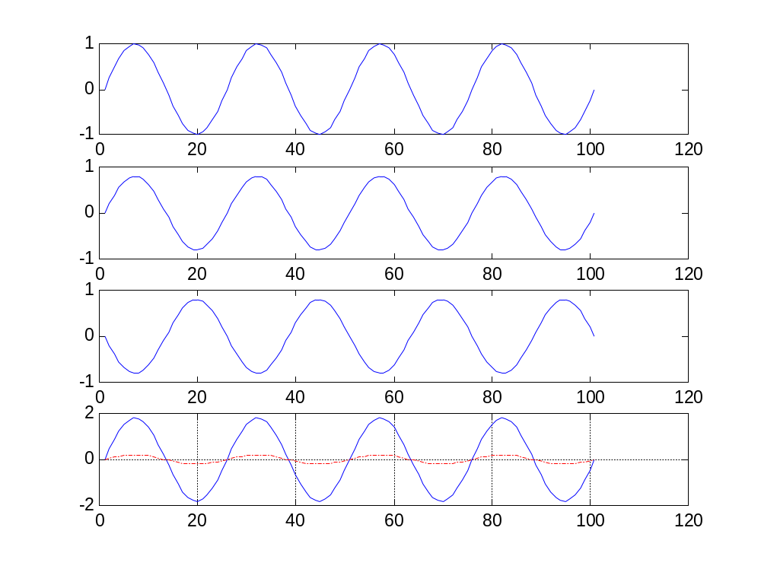
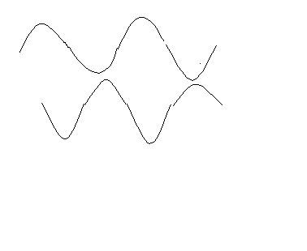
Multipath Fading
First Path
Echo path
(case 1)
Echo path (case 2)
Constructive addition (case 1)
Destructive addition (case 2)
Notes:
As a mobile moves over very small distances, the instantaneous received signal strength may fluctuate rapidly giving rise to small-scale fading. The reason for this is that the received signal is a sum of many contributions coming from different directions, as described in Chapter 5. Since the phases are random, the sum of the contributions varies widely; for example, obeys a Rayleigh fading distribution. In small-scale fading, the received signal power may vary by as much as three or four orders of magnitude (30 or 40 dB) when the receiver is moved by only a fraction of a wavelength. As the mobile moves away from the transmitter over much larger distances, the local average received signal will gradually decrease, and it is this local average signal level that is predicted by large-scale propagation models

Slide 13
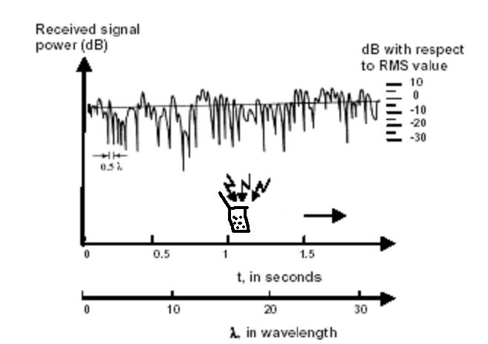
Large-Scale & Small-Scall Fading
Notes:
Typically, the local average received power is computed by averaging signal measurements over a measurement track of 5 λ, to 40 λ . For cellular and PCS frequencies in the 1 GHz to 2 GHz band, this corresponds to measuring the local average received power over movements of 1 m to 10 m.
Figure 4.1 illustrates small-scale fading and the more gradual large-scale variations for an indoor radio communication system. Notice in the figure that the signal fades rapidly (small-scale fading) as the receiver moves, but the local average signal changes much more gradually with distance. This chapter covers large-scale propagation and presents a number of common methods used to predict received power in mobile communication systems. Chapter 5 treats small-scale fading models and describes methods to measure and model multipath in the mobile radio environment.

Slide 14
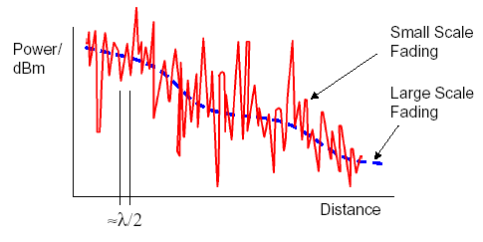
Large-Scale & Small-Scall Fading (Contd.)
The distance between small scale fades is on the order of λ/2

Slide 15
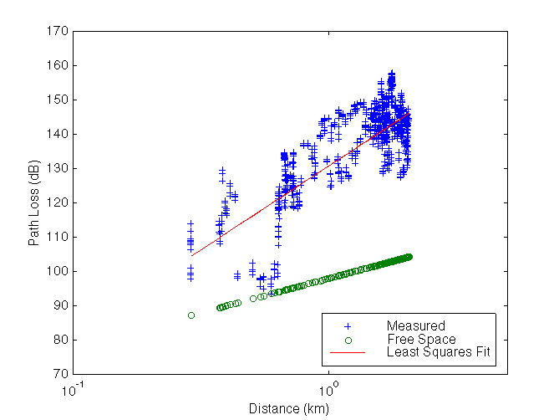
Path Loss
Notes:
least squares: a method of fitting a curve to data points so as to minimize the sum of the squares of the distances of the points to the curve.
L: System loss factor L≥1

Slide 16
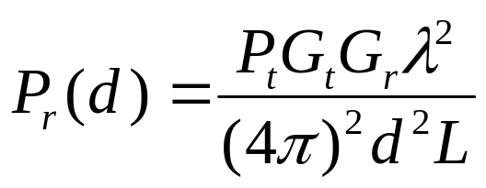
Propagation Models
Free Space Propagation Model - LOS path exists between T-R
May applicable for satellite communication or microwave LOS links
Frii’s free space equation:
  Pt : Transmitted power
  Pr : Received power
  Gt : Transmitter gain
  Gr: Receiver gain
  d: Distance of T-R separation
  L: System loss factor L≥1
  λ: Wavelength in meter
Notes:
Free Space Propagation Model
The free space propagation model is used to predict received signal strength when the transmitter and receiver have a clear, unobstructed line-of-sight path between them. Satellite communication systems and microwave line-of-sight radio links typically undergo free space propagation. As with most large-scale radio wave propagation models, the free space model predicts that received power decays as a function of the T-R separation distance raised to some power (i.e. a power law function). The free space power received by a receiver antenna which is separated from a radiating transmitter antenna by a distance d, is given by the Friis free space equation,
The values for P_{t} and P_{r}, must be expressed in the same units, and G_{t} and G_{r} are dimensionless quantities. The miscellaneous losses L (L ≥ 1) are usually due to transmission line attenuation, filter losses, and antenna losses in the communication system. A value of L = 1 indicates no loss in the system hardware.
The Friis free space equation of (4. 1) shows that the received power falls off as the square of the T-R separation distance. This implies that the received power decays with distance at a rate of 20 dB/decade.

Slide 17
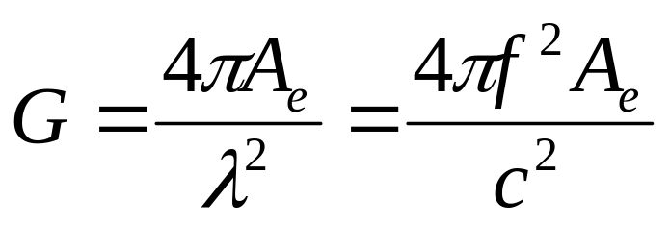
Antenna Gain
Relationship between antenna gain and effective area
    G = antenna gain
    A_{e} = effective area
    f = carrier frequency
    c = speed of light (3 * 10⁸ m/s)
    λ = carrier wavelength
Notes:
An isotropic radiator is an ideal antenna which radiates power with unit gain uniformly in all directions, and is often used to reference antenna gains in wireless systems. The effective isotropic radiated power (EIRP) is defined as
EIRP = P_{t}G_{t} and represents the maximum radiated power available from a transmitter in the direction of maximum antenna gain, as compared to an isotropic radiator.
In practice, effective radiated power (ERP) is used instead of EIRP to denote the maximum radiated power as compared to a half-wave dipole antenna (instead of an isotropic antenna). Since a dipole antenna has a gain of 1.64 (2.15 dB above an isotropic), the ERP will be 2.15 dB smaller than the EIRP for the same transmission system. In practice, antenna gains are given in units of dBi (dB gain with respect to an isotropic antenna) or dBd (dB gain with respect to a half-wave dipole).

Slide 18
Relating Power to Electric Field
In free space, the power flux density P_{d} (in W/m²) is given by
P_{d} = EIRP / 4πd² = P_{t} G_{t} / 4πd²
Or in another form
P_{d} = E² / R_{fs} = E² / η W/m²
where R_{fs} is the intrinsic impedance of free space given by η=120π Ω = 377 Ω, then
P_{d} = E² / 120π W/m²
Notes:
EIRP: effective isotropic radiated power.
E:represent the magnitude of the radiating portion of the electric field in the far field.

Slide 19
Relating Power to Electric Field (Contd.)
At the end of receiving antenna
P_{r}(d) = P_{d} A_{e} = A_{e} (E² / 120 π)Ω
where Ae is the effective aperture of the receiving antenna
Or when L=1, which means no hardware losses are taken into
consideration
P_{r}(d) = P_{t} G_{t} G_{r} λ² / (4π)² d²
Notes:
P_{d} may be thought of as the EIRP divided by the power flux density times the effective aperture of the receiver antenna, and can be related to the electric field.

Slide 20
Propagation Models (Contd.)
Path Loss – difference (in dB) between the effective transmitted power and the received power, and may or may not include the effect of the antenna gains
Path loss for the free space model when antenna gains included
PL(dB) = 10 log(P_{t}/P_{r})
= -10 log(Gt Gr λ² / (4π)² d² L)
Path loss for the free space model when antenna gains excluded
PL(dB) = 10 log(P_{t}/P_{r})
= -10 log(λ² / (4π)² d² L)

Slide 21
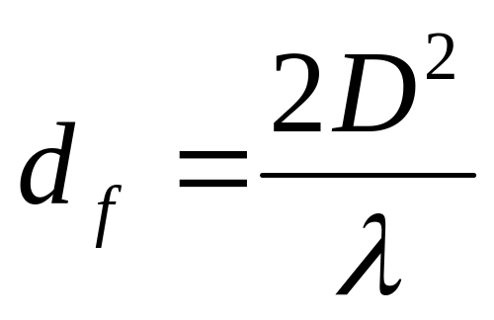
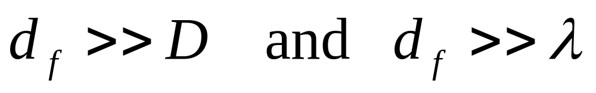
Fraunhofer distance
Where D is the largest physical linear dimension of the antenna. Additionally, to be in the far-field region, d, must satisfy
Notes:
The Friis free space model is only a valid predictor for P_{r} for values of d which are in the far-field of the transmitting antenna. The far-field, or Fraunhofer region, of a transmitting antenna is defined as the region beyond the far-field distance d_{f}, which is related to the largest linear dimension of the transmitter antenna aperture and the carrier wavelength. The Fraunhofer distance is given by

Slide 22
Propagation Models (Contd.)
Modified free space equation
Pr(d) = Pr(d₀)(d₀/d)² d ≥ d₀ ≥ d_{f}
Modified free space equation in dB form
Pr(d) dBm = 10 log[Pr(d₀)/0.001W] + 20 log(d₀/d)
where P_{r}(d₀) is in units of watts.
d_{f} is Fraunhofer distance which complies:
d_{f} =2D²/λ
where D is the largest physical linear dimension of the antenna
In practice, reference distance is chosen to be 1m (indoor) and 100m or 1km(outdoor) for low-gain antenna system in 1-2 GHz region.
Notes:
Furthermore, it is clear that Equation (4.1) does not hold for d = 0. For this reason, large-scale propagation models use a close-in distance, d_{o}, as a known received power reference point. The received power, P_{r}(d), at any distance d > d_{o}, may be related to P_{r} and d_{o}. The value P_{r}(d₀) may be predicted from Equation (4. 1), or may he measured in the radio environment by taking the average received power at many points located at a close-in radial distance d_{o} from the transmitter. The reference distance must be chosen such that it lies in the far-field region, that is,
d_{o} > d_{f}, and d_{o} is chosen to be smaller than any practical distance used in the mobile communication system. Thus, using Equation (4.1), the received power in free space at a distance greater than d_{o} is given by
In mobile radio systems, it is not uncommon to find that P_{r} may change by many orders of magnitude over a typical coverage area of several square kilometers. Because of the large dynamic range of received power levels, often dBm or dBW units are used to express received power levels. Equation (4.8) may be expressed in units of dBm or dBW by simply taking the logarithm of both sides and multiplying by 10. For example, if P_{r} is in units of dBm, the received power is given by
The reference distance d_{o} for practical systems using low-gain antennas in the 1-2 GHz region is typically chosen to be 1 m in indoor environments and 100 m or 1 km in outdoor environments, so that the numerator in Equations (4.8) and (4.9) is a multiple of 10. This makes path loss computations easy in dB units.

Slide 23
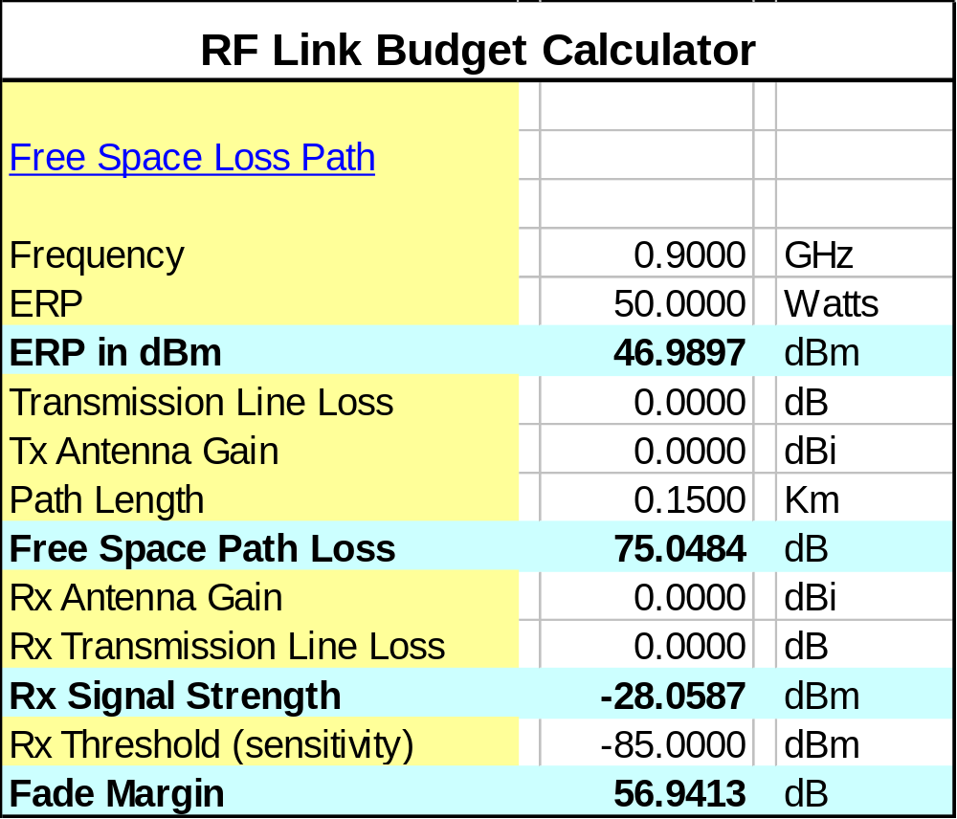
Example (link budget)
Notes:
λ=c/f = 3*10⁸ / 900*10⁶ = 1/3 m
PL= 10 log (4πd/ λ)² = 20log (4*3.14*150*3)=75.048 dB
P_{r} = P_{t} – PL (dB) = 46.9897 – 75.0484 = -28.0587 dBm
Rx threshold (sensitivity) -85 dB

Slide 24
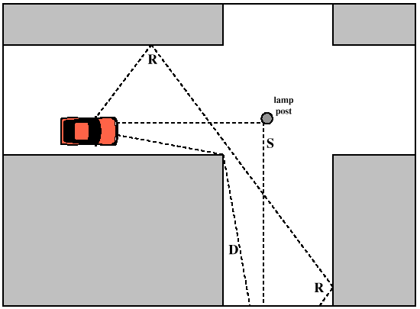
Large-scale Path Loss (Part 2)
The three basic Propagation Mechanisms
Reflection
Diffraction
Scattering
Notes:
Reflection, diffraction, and scattering are the three basic propagation mechanisms which impact propagation in a mobile communication system. These mechanisms are briefly explained in this section, and propagation models which describe these mechanisms are discussed subsequently in this chapter. Received power (or its reciprocal, path loss) is generally the most important parameter predicted by large-scale propagation models based on the physics of reflection, scattering, and diffraction. Small-scale fading and multipath propagation (discussed in Chapter 5) may also be described by the physics of these three basic propagation mechanisms.
Reason for discussing these Propagation Mechanisms
They have an impact on the wave propagation in a mobile communication system
The most important parameter, Received power is predicted by large scale propagation models based on the physics of reflection, diffraction and scattering

Slide 25
Reflection, Diffraction and Scattering
Reflection occurs when a propagating electromagnetic wave impinges upon an object which has very large dimensions when compared to the wavelength of the propagating wave.
Diffraction occurs when the radio path between the transmitter and receiver is obstructed by a surface that has sharp irregularities (edges).
Scattering occurs when the medium through which the wave travels consists of objects with dimensions that are small compared to the wavelength, and where the number of obstacles per unit volume is large.
Notes:
Reflections occur from the surface of the earth and from buildings and walls.
Diffraction occurs when the radio path between the transmitter and receiver is obstructed by a surface that has sharp irregularities (edges). The secondary waves resulting from the obstructing surface are present throughout the space and even behind the obstacle, giving rise to a bending of waves around the obstacle, even when a line-of-sight path does not exist between transmitter and receiver. At high frequencies, diffraction, like reflection, depends on the geometry of the object, as well as the amplitude, phase, and polarization of the incident wave at the point of diffraction.
Scattering occurs when the medium through which the wave travels consists of objects with dimensions that are small compared to the wavelength, and where the number of obstacles per unit volume is large. Scattered waves are produced by rough surfaces, small objects, or by other irregularities in the channel. In practice, foliage, street signs, and lamp posts induce scattering in a mobile communications system.

Slide 26
Reflection
Fresnel Reflection Coefficient (Γ)
It gives the relationship between the electric field intensity of the reflected and transmitted waves to the incident wave in the medium of origin.
The Reflection Coefficient is a function of the material properties
It depends on
Wave Polarization
Angle of Incidence
Frequency of the propagating wave
Notes:
When a radio wave propagating in one medium impinges upon
another medium having different electrical properties, the
wave is partially reflected and partially transmitted
If the plane wave is incident on a perfect dielectric, part of the
energy is transmitted into the second medium and part is reflected
back into the first medium
There is no loss of energy in absorption
If the second medium is a perfect conductor, then all the incident
energy is reflected back into the first medium without any loss of
energy
In general, electromagnetic waves are polarized
Polarization means that the EM waves have instantaneous electric field
components in orthogonal directions in space.
A polarized wave may be mathematically represented as the sum of two
spatially orthogonal components, such as vertical and horizontal components

Slide 27
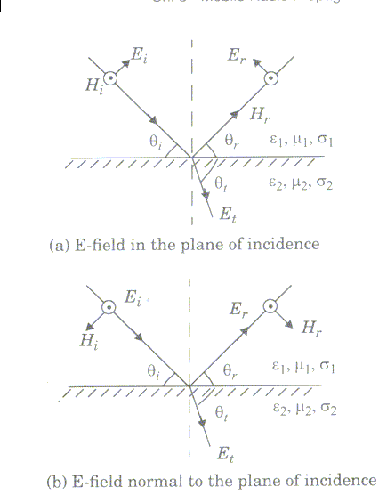
Reflection from Dielectrics
Notes:
EM wave is incident at an angle θ_{i} with the plane of the boundary between the two dielectric media
Part of the energy is reflected back to the first media at an angle θ_{r} and part is transmitted ( refracted) into the second media at an angle θ_{t}
The plane of incidence is defined as the plane containing the incident, reflected and transmitted rays
The nature of reflection varies with the direction of polarization of the
E - field

Slide 28
The behavior for arbitrary directions of polarization is illustrated through
the two distinct cases in the figure
Case 1
The E - field polarization is parallel with the plane of incidence
i.e. the E - field has a vertical polarization, or normal component
with respect to the reflecting surface
Case 2
The E - field polarization is perpendicular to the plane of incidence
i.e. the E - field is parallel to the reflecting surface ( normal to the
page and pointing out of it towards the reader)

Slide 29
The dielectric constant ε of a perfect (lossless) dielectric is given by
ε = ε₀ ε_{r}
where ε_{r} is the relative permittivity
and ε₀ = 8.85 * 10⁻¹² F/ m
The dielectric constant ε for a power absorbing, lossy dielectric is
ε = ε₀ ε_{r} - j ε’
where ε’ = σ / 2π f
Notes:
Subscripts i, r, t refer to the incident, reflected and transmitted fields
Parameters ε₁, μ₁, σ₁ and ε₂, μ₂, σ₂ represent permittivity, permeability and conductivity of the two media
ε_{r} and σ are normally insensitive to operating frequency for a good
conductor
For lossy dielectrics, ε₀ and ε_{r} are generally constant with frequency,
but σ may be sensitive to the operating frequency

Slide 30
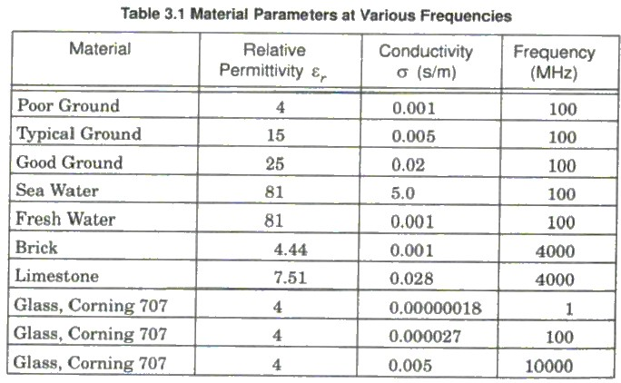
Notes:
Electrical properties of a wide range of materials were characterized over a
large frequency range by Von Hipple

Slide 31
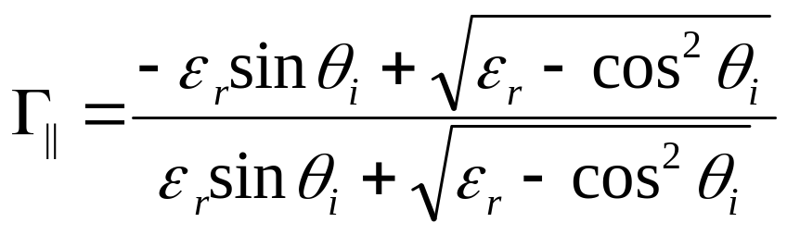
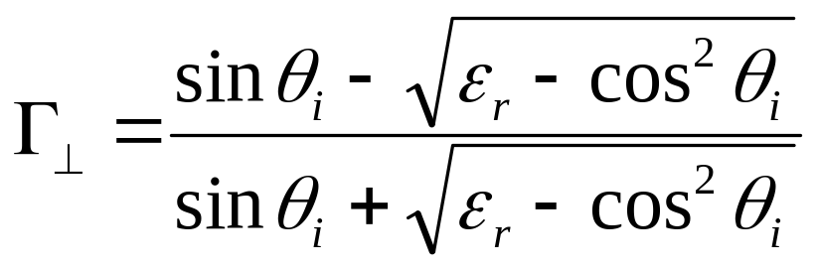
In the case when the first medium is free space and μ₁ = μ₂
the Reflection coefficients for the two cases of vertical and horizontal polarization can be simplified to
Notes:
In the general case of reflection and transmission, the horizontal and vertical
axes of the spatial co-ordinates may not coincide with the _ and || axes of the
propagating waves
An angle θ measured counter- clockwise from the horizontal axis is defined in
in the figure for a propagating wave out of the page

Slide 32
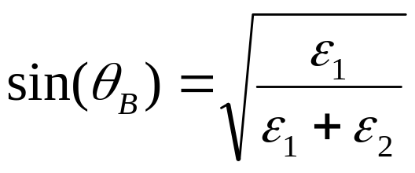
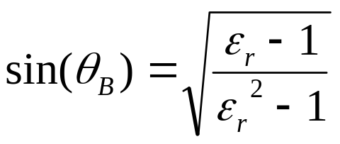
Brewster Angle
It is the angle at which no reflection occurs in the medium of origin
It occurs when the incident angle θ_{B} is such that the Reflection Coefficient Γ| | = 0
For the case when the first medium is free space and the second medium has a relative permittivity ε_{r} , the above equation can be expressed as
Notes:
Brewster Angle occurs only for vertical ( i.e. parallel ) polarization

Slide 33
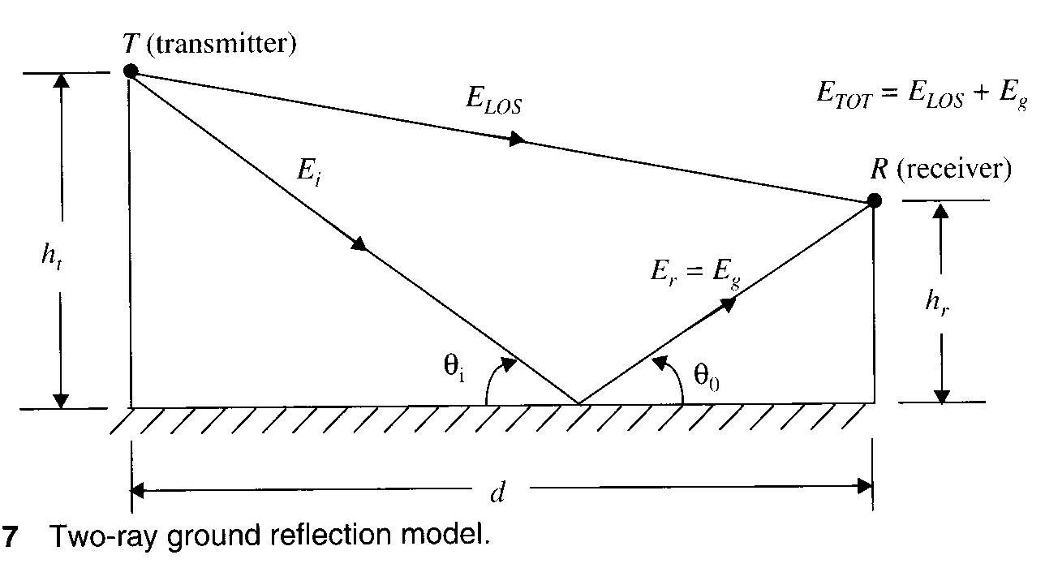
Ground Reflection (Two- Ray) Model
Notes:
In a mobile radio channel, a single direct path between the base station
and mobile is rarely the only physical path for propagation
Hence the free space propagation model in most cases is inaccurate
when used alone
The 2- ray GRM is based on geometric optics
It considers both- direct path and ground reflected propagation path between transmitter and receiver
This was found reasonably accurate for predicting large scale signal
strength over distances of several kilometers for mobile radio systems
using tall towers ( heights above 50 m ), and also for L-O-S micro cell
channels in urban environments

Slide 34
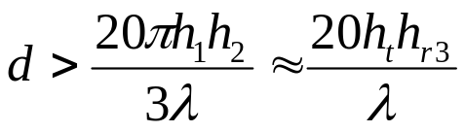
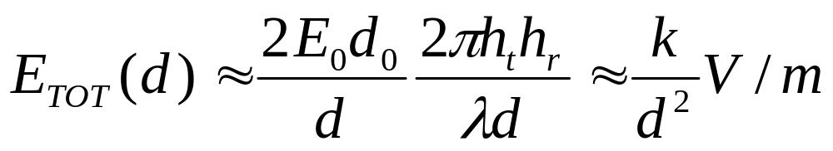
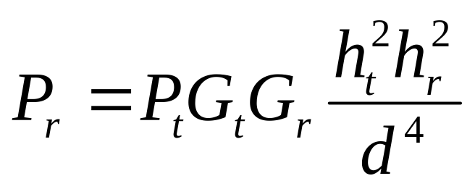
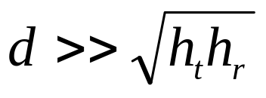
_{Whenever}
The received E-field can be approximated
The power received at distance d is given by
For large T- R distances so received power falls off to the 4th power of d, or at 40 db/ decade
Notes:
K is a constant related t E₀, the antenna height,and the wavelength.
This power loss is much more than in free space
At large values of d, the received power and path loss become independent of frequency.
The path loss for the 2- ray model in db
PL (db) = 40 log d – ( 10 log G_{t} + 10 log G_{r} + 20 log h_{t} + 20 log h_{r} )

Slide 35
This power loss is much more than that in free space
At large values of d, the received power and path loss become independent of frequency.
The path loss for the 2- ray model in db
PL (db) = 40 log d – ( 10 log G_{t} + 10 log G_{r} + 20 log h_{t} + 20 log h_{r} )

Slide 36
Diffraction
Phenomena: Radio signal can propagate around the curved surface of the earth, beyond the horizon and behind obstructions.
Huygen’s principle: All points on a wavefront can be considered as point sources for the production of secondary wavelets and these wavelets combine to produce a new wavefront in the direction of propagation.
The field strength of a diffracted wave in the shadowed region is the vector sum of the electric field components of all the secondary wavelets in the space around the obstacles.
Notes:
Although the received field strength decreases rapidly as a receiver moves deeper into the obstructed ( shadowed ) region, the diffraction field still exists and often has sufficient strength to produce a useful signal

Slide 37
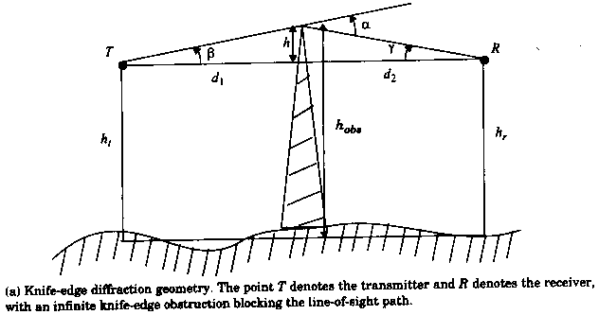
Fresnel Zone Geometry
The wave propagating from the transmitter to the receiver via the top of the screen travels a longer distance than if a direct line-of-sight path exists.
Notes:
Let’s consider a transmitter and receiver separated in free space by an obstructing screen with infinite width.
h – effective height of the obstruct
d1 – distance of the obstruct from the transmitter
d2 – distance of the obstruct from the receiver
– the wavelength of the radio wave
Assume h << d1, h << d2, h >>λ

Slide 38
Fresnel Zone Geometry(Cont’d)
Angle ,
Fresnel-Kirchoff diffraction parameter
Normalizing ,
Notes:
From the above equations, it is clear that the phase difference between a direct line-of-sight path and diffracted path is a function of height and position of the obstruction, as well as the transmitter and receiver location.

Slide 39
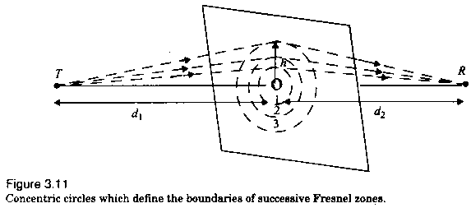
Fresnel Zone Geometry(Cont’d)
The concentric circles on the plane are Fresnel Zones.
Notes:
The conception of diffraction loss as a function of the path difference around an obstruction is explained by Fresnel zones.
Fresnel zones represent successive regions where secondary waves have a path length from the transmitter to receiver which are nλ/2 greater than the total path length of a line-of-sight path.
Fresnel zones: the concentric circles on the plane which represents the loci of the origins of secondary wavelets which propagate to the receiver such that the total path length increases by λ/2 for successive circles.

Slide 40
The radius of the nth Fresnel zone circle
The excess total path length traversed by a ray passing through each circle is
Notes:
The successive Fresnel zones have the effect of alternately providing constructive and destructive interference to the total received signal.
Fresnel zones will have maximum radii if the plane is midway between the transmitter and receiver. The radii will become smaller when the plane is moved towards either the transmitter or the receiver.
The path traveling through the smallest circle corresponding to n=1 will have an excess path
lengths of λ/2 as compared to a line-of-sight path
When an obstacle blocks the transmission path, a family of ellipsoids can be constructed between the transmitter and receiver by joining all the points for which the excess path delay is an integer multiple of half wavelength.
Rule of thumb for design of LOS microwave links
As long as 55% of the first Fresnel zone is kept clear, then further Fresnel zone clearance does not significantly alter the diffraction loss.

Slide 41
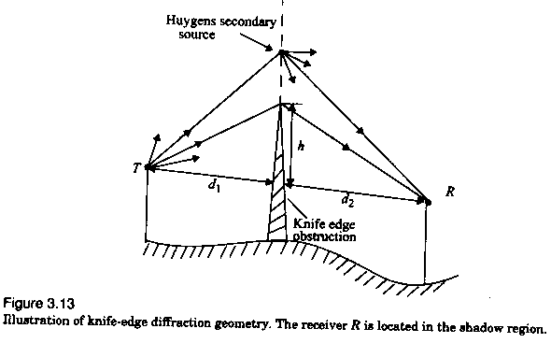
Consider a receiver at point R, located in the shadowed region.
The electric field strength Ed,
where E0 is the free space field strength
Notes:
It is essential to estimate the signal attenuation caused by diffraction of radio waves over hills and buildings in predicting the field strength in the given service area.
Two methods: (based on diffraction parameter)
Graphical solutions
Numerical solutions
In practice, prediction for diffraction loss is a process of theoretical approximation modified by necessary empirical corrections.
The simplest case: shadowing is caused by a single object such as a hill or mountain.
The attenuation caused by the diffraction can be estimated by treating the obstruction as a diffracting knife edge.
The diffraction loss in this case can be readily estimated using the classical Fresnel solution for the field behind a knife edge.
The field strength at point R is a vector sum of the fields due to all of the secondary Huygen’s sources in the plane above the knife edge.

Slide 42
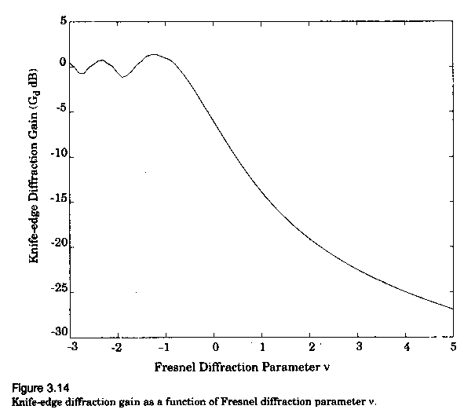
The diffraction gain:
Graphical representation of

Slide 43
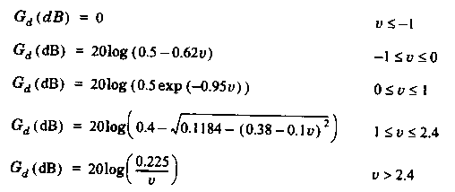
Lee’s approximate solution:

Slide 44
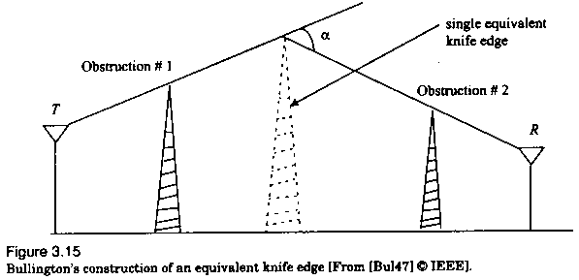
Multiple Knife-edge Diffraction
Notes:
In the practical situations, especially in hilly terrain, the propagation path may consist of more than on obstruction.
Optimistic solution (by Bullington): The series of obstacles are replaced by a single equivalent obstacle so that the path loss can be obtained using single knife-edge diffraction models.
Rigorous solution: a wave-theory solution for the field behind two knife edges in series.(Millington)
This solution is very useful and can be applied easily for predicting diffraction losses due to two knife edges. Extending this to more than two knife edges becomes a formidable problem.
Many models that are mathematically less complicated have been developed to estimate the diffraction losses due to multiple obstructions.

Slide 45
Scattering:
Large-scale Path Loss (part 4)
When does Scattering occur?
When the medium through which the wave travels consists of objects with dimensions that are small compared to wavelength
The number of obstacles per unit volume is large
How are these waves produced:
By rough surfaces, small objects or by other irregularities in the channel
Normally street signs, lamp posts, trees induce scattering in mobile communication system
Notes:
Scattering is one of the basic mechanism behind electromagnetic wave propagation in a mobile communication system.
Note:
The actual received signal in a mobile radio environment is often stronger than what is predicted by reflection and diffraction
Reason:
When a radio wave impinges on a rough surface,the reflected energy is spread in all directions due to scattering

Slide 46
Rayleigh Criterion:
Surface roughness is tested using the Rayleigh criterion,its given by
h_{c}= λ/8sinθ_{i}
where,
θ _{i} is the angle of incidence
h_{c} is the critical height of surface protuberance
for a given θ _{i}
The surface is considered smooth if the minimum to maximum protuberance h <= h_{c} and rough if h> h_{c}

Slide 47
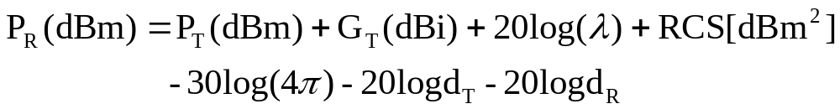
Radar cross section model:
The radar cross section (RCS) of a scattering object is defined as the ratio of the power density of the signal scattered in the direction of the receiver to the power density of the radio wave incident upon the scattering object, and has units of square meters.
Bistatic radar equation
Notes:
Why do we require this?
In radio channels where large, distant objects induce scattering, the physical location of such objects can be used to accurately predict scattered signal strengths.
For urban mobile radio systems ,models based on the bistatic radar equation is used to compute the received power due to scattering in the far field.
The bistatic radar equation describes the propagation of a wave traveling in free space which impinges on a distant scattering object, and is the reradiated in the direction of the receiver, given by
Where d_{T} and d_{R} are the distance from the scattering object to the transmitter and receiver respectively.
In the above equation the scattering object is assumed to be in the(far field) Fraunhofer region of both the transmitter and receiver and is useful for predicting receiver power which scatters off large objects such as buildings, which are for both the transmitter and receiver.
For medium and large size buildings located 5-10km away, RCS values were found to be in the range of 14.1db-m² to 55.7 db-m²

Slide 48
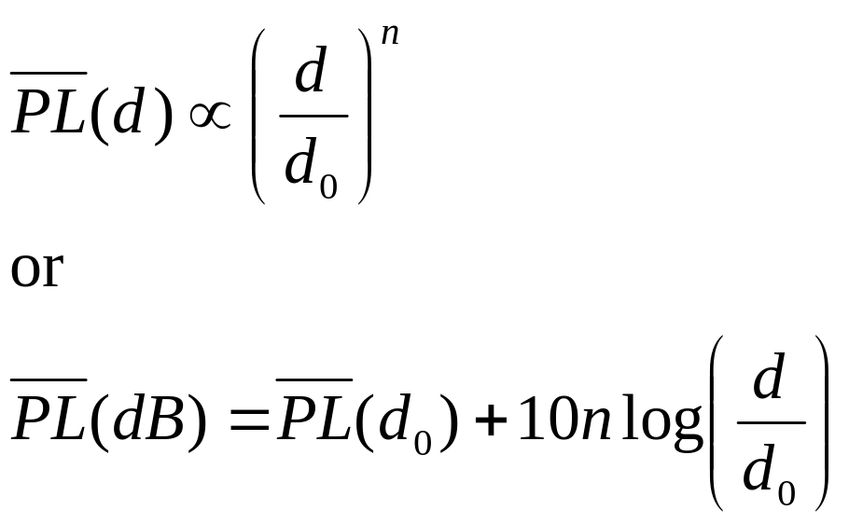
Practical link budget design using path loss models
Log –distance Path Loss Model
n is the path loss exponent which indicates the rate at which the path loss increases with distance,
Notes:
Radio Propagation models are derived using a combination of empirical and analytical methods. These methods implicitly take into account all the propagation factors both known and unknown through the actual measurements.
Path loss models are used to estimate the received signal level as a function of distance.With the help of this model we can predict SNR for a mobile communication system.
There are two such models
Log - Distance Path Loss Model
Both theoretical and measurement-based propagation models indicate that the average signal power decreases logarithmically with distance,whether in outdoor or indoor radio channels.
The average large-scale path loss for an arbitrary T-R separation is expressed as a function of distance by using path loss exponent,n
a ∝ b, a varies directly as b.
the bars in the above equations denote the average of all the possible path loss values for a given value of d
n is the path loss exponent which indicates the rate at which the path loss increases with distance,
d₀ is the close-in reference distance which is determined from measurements close to the transmitter,and
d is the T-R separation distance.
Log - Normal Shadowing

Slide 49
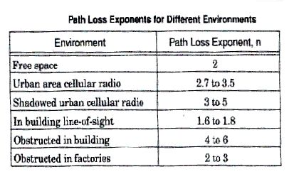
Notes:
When plotted on a log-log scale ,the modeled path loss is a straight line with slope equal to 10n dB per decade
The value of ‘n’ depends on the specific propagation environment
For example, in free space the value on n is equal to 2, and when obstructions are present,n will have a larger value
Considerations:
It is important to select a free space reference distance that is appropriate for the propagation environment
In large coverage cellular systems ,1km reference distance are commonly used,where as in microcellular systems,much smaller distances(such as 100m or 1m) are used
The reference distance should always be in the far field of the antenna so that near-field effects do not alter the reference path loss

Slide 50
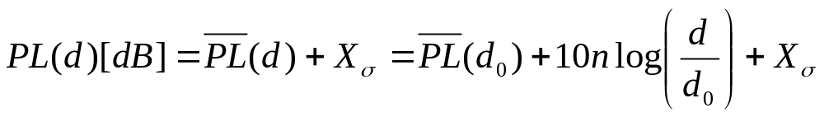
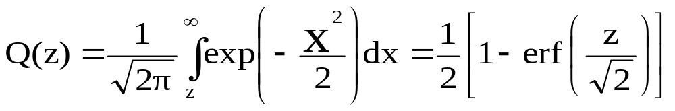
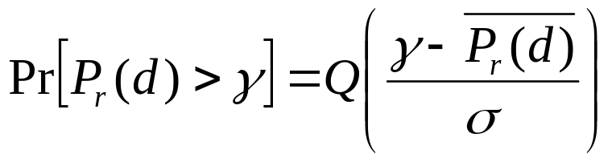
Log-normal Shadowing:
X_{σ} is the Zero –mean Gaussian distributed random variable with standard deviation σ(also in dB)
PL(d) is a random variable with a normal distribution.Define
The probability that the received signal level will exceed a certain value γ can be calculated from the cumulative density function as
Notes:
Log distance path loss model does not consider the fact that the surrounding environmental clutter may be vastly different at two different locations having the same T-R separation
This produces a change in the measured signals which is vastly different from the average value predicted by the previous model
The path loss at a particular location for any value of d is random and distributed log-normally about the mean distance- dependent value is given by
It describes the random shadowing effects which occur over a large number of measurement locations which have the same T-R separation,but have different levels of clutter on the propagation path.
The random effects of shadowing are accounted for using the Gaussian distribution
The close-in reference distance d₀,the path loss exponent n,and the standard deviation σ, statistically describe the path loss model for an arbitrary location having a specific T-R separation
In practice ,the values of n and σ are computed from measured data,using linear regression such that the difference between the measured and estimated path losses is minimized in a mean square error sense over a wide range of measurement locations and T-R separations
The value of PL(d₀) is based on either close-in measurements or on a free space assumption from the transmitter to d₀
The figure shows actual measured data in several cellular radio systems and demonstrates the random variations about the mean path loss(in dB) due to shadowing at specific T-R separations
Now, considering PL(d) and P_{r}(d) which take random values with respect to the variable d(distance)
To determine the probability whether the received signal will exceed or fall below a particular level ,the Q-function or error function(erf) is used and is defined as:

Slide 51
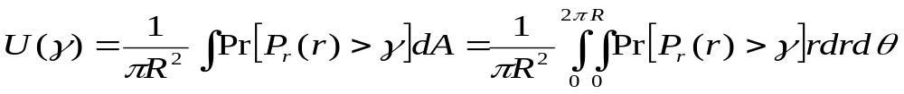
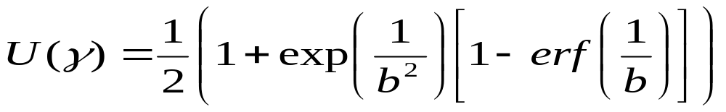
Determination of Percentage of Coverage Area
Notes:
Due to the random effects of shadowing some locations within the coverage area will be below a particular desired received signal level
So,its better to compute how the boundary coverage area relates to the percent of area covered within the boundary
Considering a circular coverage area having radius R from the base station,and let the received threshold signal be γ
Now,calculating U(γ ), the percentage of useful service area (i.e the percentage area with a received signal that is equal to or greater than γ )
Let d = r represent the radial distance from the transmitter,it can be shown that if P_{r}[P_{r}(r) > γ] is the probability that the random received at d=r exceeds the threshold γ with an incremental area dA and U(γ ) is given by

Slide 52
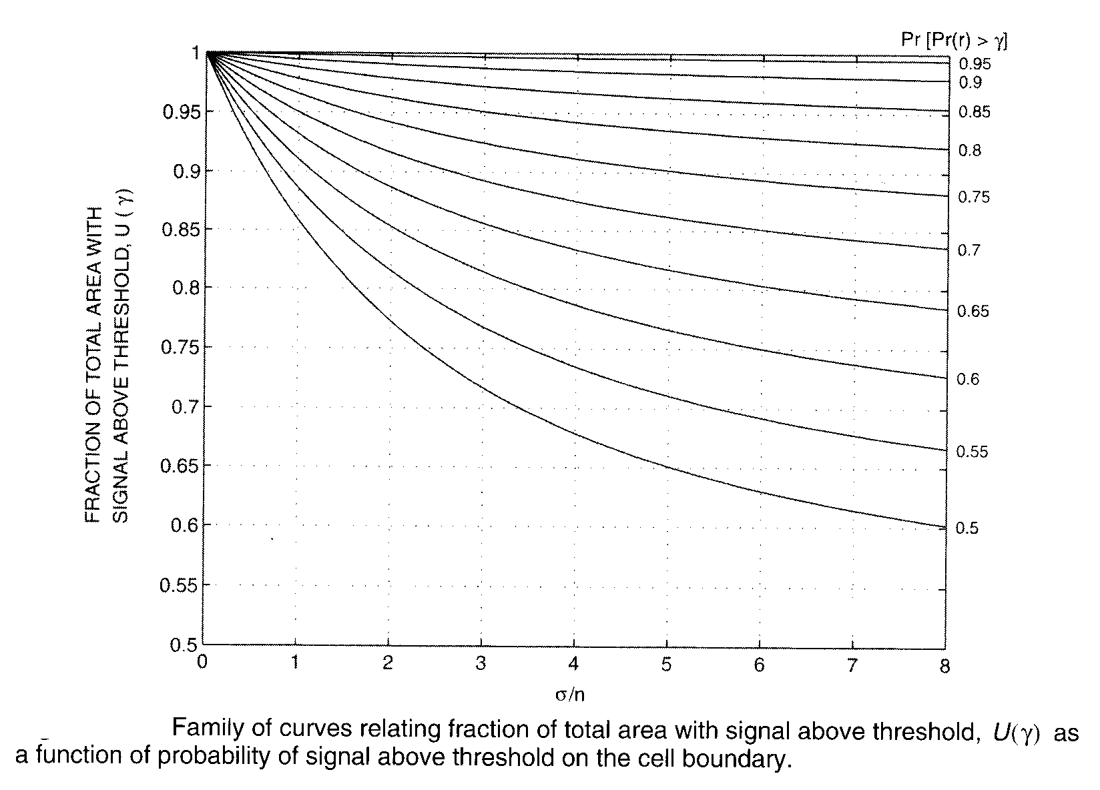
Notes:
Equation (4.78) may be evaluated for a large number of values of σ and n, as shown in Figure 4.18. For example, if n = 4 and σ = 8 dB, and if the boundary is to have 75% boundary coverage (75% of the time the signal is to exceed the threshold at the boundary), then the area coverage is equal to 94%. If n = 2 and σ = 8 dB, a 75% boundary coverage provides 91 % area coverage. If n = 3 and σ = 9 dB, then 50% boundary coverage provides 71 % area coverage.

